Slide 1
Lab 8 Detailed Design Tasks
Notes:
1

Slide 2
Issues
Teachers
Issue 1: Architecture Design Diagram Review
Issue 2: Teacher explains the Detailed Design template
Students
Task 1: Students prepare Detailed Design document
4/22/2026
2

Slide 3
Issue 1: Architecture Diagram Review
Feedback:
1.3 Purpose of architecture design: divide the system into subsystems, so they can be developed individually.
2.1 Use case diagram and class diagram
Change the class diagram into architectural design.
Some teams made changes to the class diagram we gave you or even ignored it altogether.
Consider which subsystem each use cases belongs.
Many teams didn’t follow the given use cases and create their own in the UI.
2.2 Design model includes both MVC and three-layered models
4/22/2026
3
Notes:
1. Project introduction I simply shows the students first simple version of the project description which is on iSpace already
2. Interview skills introduce very common interview skills used in industry like email, phone, face to face, question list
3. The purpose to explain SRS is for students to further understand, before start a software development, what should be known. Students shall ask the questions so they can fill in the SRS document. So question list version 2 should be more complete and organized.
4. Students should not ask the questions in the following areas. These are not issues in “Software Requirements”
Cost
– Delivery schedules
– Reporting procedures
– Software development methods
– Quality assurance
– Validation and verification criteria
– Acceptance procedures.
5. So far, we will not tell students the development language that will be used. The decision on language should be put as late as possible.
6. We will behave in the role of customer or client who knows very little about computers. Students should ask in a way that such clients are able to understand. Therefore, they should avoid the use of jargon.
7. In the SRS template, there is an explanation about each section. More attentions should be paid here:
1)Section 1.1 is not the purpose of this project, it is the purpose of this document.
2)References are not software engineering books. It is about the documents in a company which is related to this system and can help understand this system.
3)Software interface exists only when a software system is a subsystem or a module of a whole system. 4)Hardware exists when embedded software is developed.

Slide 4
Issue 1: Architecture Diagram Review
Feedback – 2.3 whole system architecture
Whole system architecture diagram is missing in some teams.
Whole system architecture must be consistent with the class diagram in 2.1
Every class in 2.1 must appear in diagram in 2.3.
Every class in 2.3 must appear in diagram in 2.1.
The whole system architecture in 2.3
Shows how the system is divided into subsystems,
Shows how the subsystems are coupled with each other,
Contains class names, but no attributes, operations, UI or database, those things belong to Section 3 subsections.
A class cannot appear in 2 subsystems.
Otherwise, those 2 subsystems would be highly coupled together, and cohesion is low with each subsystem.
4/22/2026
4
Notes:
1. Project introduction I simply shows the students first simple version of the project description which is on iSpace already
2. Interview skills introduce very common interview skills used in industry like email, phone, face to face, question list
3. The purpose to explain SRS is for students to further understand, before start a software development, what should be known. Students shall ask the questions so they can fill in the SRS document. So question list version 2 should be more complete and organized.
4. Students should not ask the questions in the following areas. These are not issues in “Software Requirements”
Cost
– Delivery schedules
– Reporting procedures
– Software development methods
– Quality assurance
– Validation and verification criteria
– Acceptance procedures.
5. So far, we will not tell students the development language that will be used. The decision on language should be put as late as possible.
6. We will behave in the role of customer or client who knows very little about computers. Students should ask in a way that such clients are able to understand. Therefore, they should avoid the use of jargon.
7. In the SRS template, there is an explanation about each section. More attentions should be paid here:
1)Section 1.1 is not the purpose of this project, it is the purpose of this document.
2)References are not software engineering books. It is about the documents in a company which is related to this system and can help understand this system.
3)Software interface exists only when a software system is a subsystem or a module of a whole system. 4)Hardware exists when embedded software is developed.

Slide 5
Issue 1: Architecture Diagram Review
Feedback – 3.X Subsystems UI
Subsystems’ UI must be consistent with the use case diagram in 2.1.
All UIs in subsystems must be from the use case diagram in 2.1.
Except for HomeUI or MainUI, which are links to home pages.
Every use case in the use case diagram must appear in the UI layer of a subsystem.
A use case cannot appear in 2 different subsystems.
Otherwise, the 2 subsystems are highly coupled together, and cohesion is low with each subsystem.
4/22/2026
5
Notes:
1. Project introduction I simply shows the students first simple version of the project description which is on iSpace already
2. Interview skills introduce very common interview skills used in industry like email, phone, face to face, question list
3. The purpose to explain SRS is for students to further understand, before start a software development, what should be known. Students shall ask the questions so they can fill in the SRS document. So question list version 2 should be more complete and organized.
4. Students should not ask the questions in the following areas. These are not issues in “Software Requirements”
Cost
– Delivery schedules
– Reporting procedures
– Software development methods
– Quality assurance
– Validation and verification criteria
– Acceptance procedures.
5. So far, we will not tell students the development language that will be used. The decision on language should be put as late as possible.
6. We will behave in the role of customer or client who knows very little about computers. Students should ask in a way that such clients are able to understand. Therefore, they should avoid the use of jargon.
7. In the SRS template, there is an explanation about each section. More attentions should be paid here:
1)Section 1.1 is not the purpose of this project, it is the purpose of this document.
2)References are not software engineering books. It is about the documents in a company which is related to this system and can help understand this system.
3)Software interface exists only when a software system is a subsystem or a module of a whole system. 4)Hardware exists when embedded software is developed.

Slide 6
Issue 1: Architecture Diagram Review
Feedback – 3.X.2 database tables
A table’s attributes must match the class’ attributes.
Especially so in the detailed design we do this week.
DBMS class thoroughly covered how to use tables to represent associations between entities.
We briefly covered this in SE Lecture 10.
Recall the 10 cases in DBMS class; following 3 are most useful.
For 1 to many relation, the foreign key from the “1” table is “marked for association” in the “many” table.
For many to many relation, the foreign keys for both tables are “marked for association” in the association table.
For inheritance, we can extend the table to accommodate both the super and sub classes.
4/22/2026
6
Notes:
1. Project introduction I simply shows the students first simple version of the project description which is on iSpace already
2. Interview skills introduce very common interview skills used in industry like email, phone, face to face, question list
3. The purpose to explain SRS is for students to further understand, before start a software development, what should be known. Students shall ask the questions so they can fill in the SRS document. So question list version 2 should be more complete and organized.
4. Students should not ask the questions in the following areas. These are not issues in “Software Requirements”
Cost
– Delivery schedules
– Reporting procedures
– Software development methods
– Quality assurance
– Validation and verification criteria
– Acceptance procedures.
5. So far, we will not tell students the development language that will be used. The decision on language should be put as late as possible.
6. We will behave in the role of customer or client who knows very little about computers. Students should ask in a way that such clients are able to understand. Therefore, they should avoid the use of jargon.
7. In the SRS template, there is an explanation about each section. More attentions should be paid here:
1)Section 1.1 is not the purpose of this project, it is the purpose of this document.
2)References are not software engineering books. It is about the documents in a company which is related to this system and can help understand this system.
3)Software interface exists only when a software system is a subsystem or a module of a whole system. 4)Hardware exists when embedded software is developed.

Slide 7
Example for struggling teams
This solution is workable, courtesy of Team C08.
Beware, there are small errors in this solution.
The feedback for errors are included in the message boxes in the slides.

Slide 8
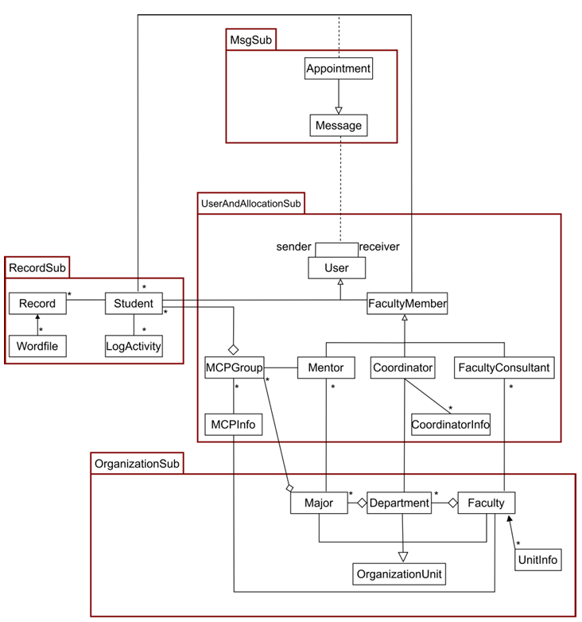
2.3 Overall System Architecture

Slide 9
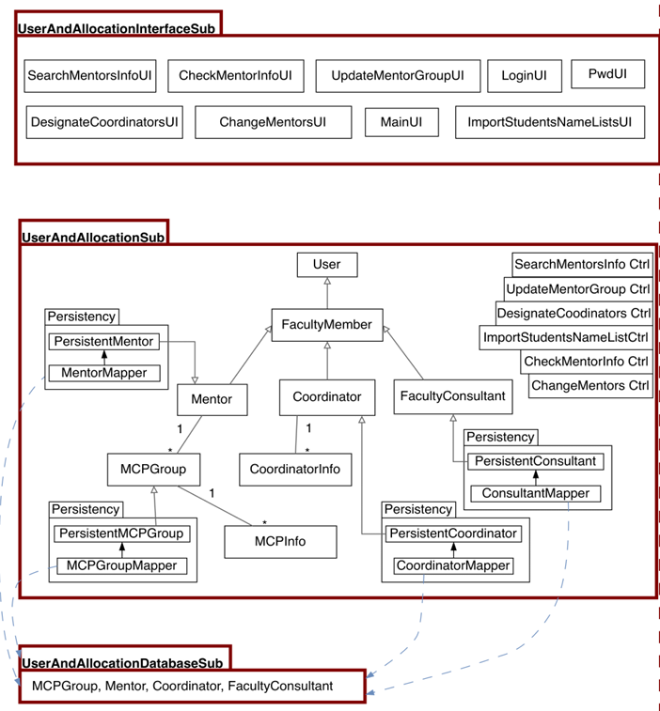
3.1 User&AllocationSub

Slide 10
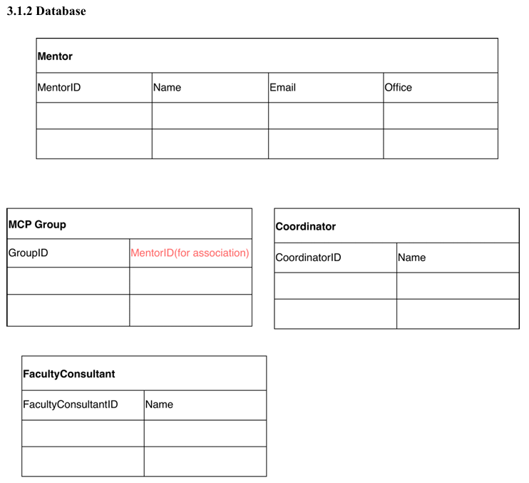
Wrong or missing attributes for associate in a table.
For 1 to many associations, the association should be in the “many” table, with the foreign key as the association. Recall the ten cases in DBMS class.
Mentor needs to have foreign key MajorID as association.
Faculty consultant needs to have foreign key FacultyID as association.

Slide 11
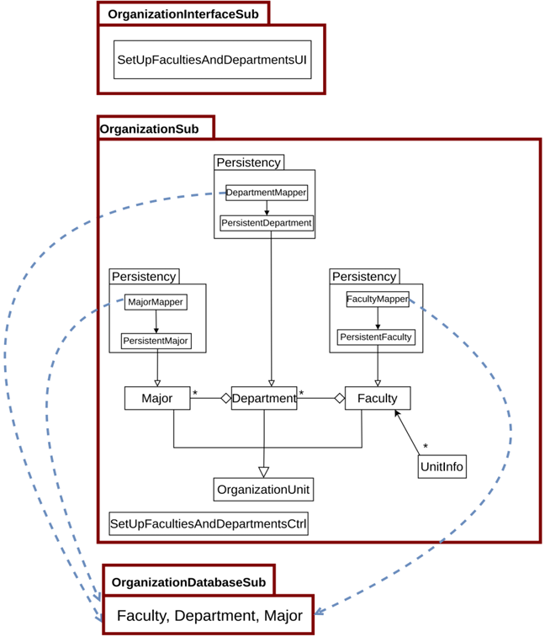
3.2 OrganizationSub

Slide 12
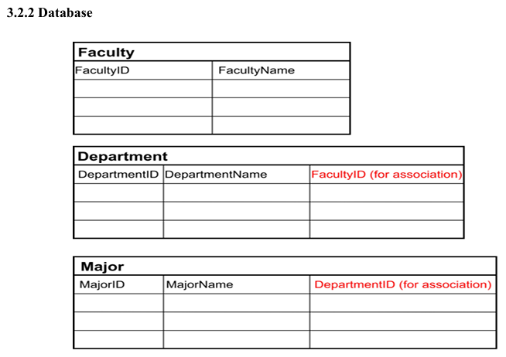

Slide 13
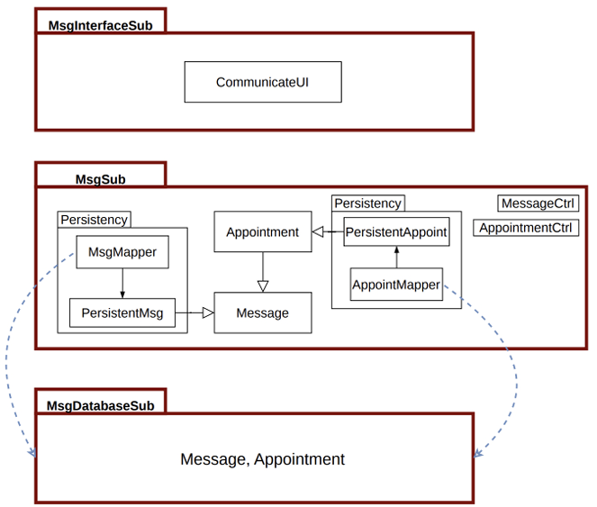
3.3 MsgSub
Controls not consistent with UI’s
Better to have CommunicateCtrl rather than MessageCtrl and AppointmentCtrl

Slide 14
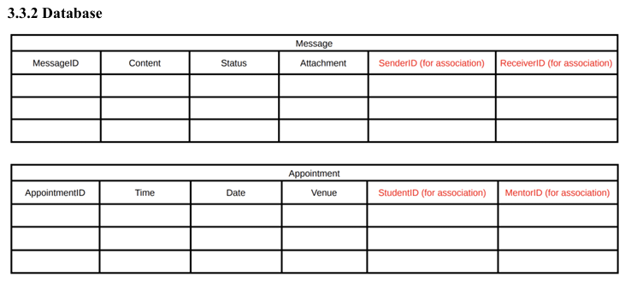

Slide 15
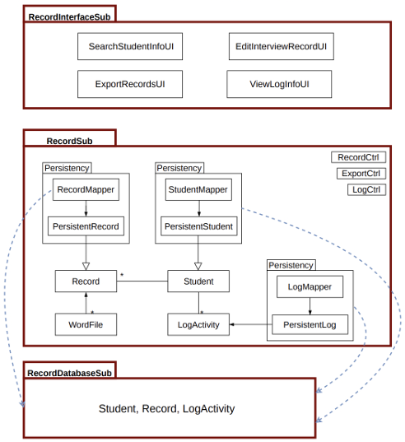
3.4 RecordSub
Controls not consistent with UI’s
Should have SearchStudentInfoCtrl etc.

Slide 16
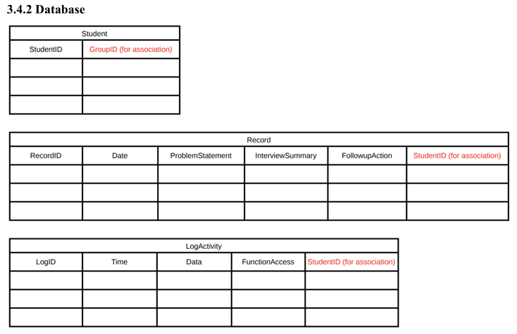

Slide 17
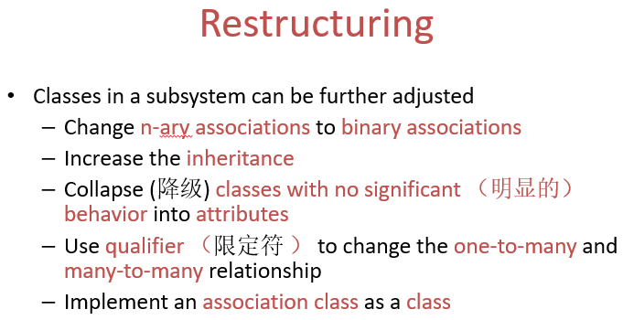
Issue 2: Detailed Design Template Explanation
Teacher explains the detailed design template. The template is available in iSpace.
Main points
Section 2.1: Whole class diagram. Same as the one you put in Section 2.1 in the Architecture Design Document
Section 3.1: Put the class diagram restructured from Section 2.1
Follow the restructuring guidelines in Lecture 11, starting around slide 18.
4/22/2026
17
Notes:
1. Project introduction I simply shows the students first simple version of the project description which is on iSpace already
2. Interview skills introduce very common interview skills used in industry like email, phone, face to face, question list
3. The purpose to explain SRS is for students to further understand, before start a software development, what should be known. Students shall ask the questions so they can fill in the SRS document. So question list version 2 should be more complete and organized.
4. Students should not ask the questions in the following areas. These are not issues in “Software Requirements”
Cost
– Delivery schedules
– Reporting procedures
– Software development methods
– Quality assurance
– Validation and verification criteria
– Acceptance procedures.
5. So far, we will not tell students the development language that will be used. The decision on language should be put as late as possible.
6. We will behave in the role of customer or client who knows very little about computers. Students should ask in a way that such clients are able to understand. Therefore, they should avoid the use of jargon.
7. In the SRS template, there is an explanation about each section. More attentions should be paid here:
1)Section 1.1 is not the purpose of this project, it is the purpose of this document.
2)References are not software engineering books. It is about the documents in a company which is related to this system and can help understand this system.
3)Software interface exists only when a software system is a subsystem or a module of a whole system. 4)Hardware exists when embedded software is developed.

Slide 18
Issue 2: Detailed Design Template Explanation (Cont.)
Starting from 3.2, describe each class in the class diagram
Replace 3.#.1 section title with real class name to be described in this section .
Put the class notation with all its attributes and operations there before giving any explanation. The class should contain the finished interface design.
Following Lecture 11, around slides 7-17.
Explanation is optional, only needed when some new attributes or operations are added from the architecture design.
4/22/2026
18
Notes:
1. Project introduction I simply shows the students first simple version of the project description which is on iSpace already
2. Interview skills introduce very common interview skills used in industry like email, phone, face to face, question list
3. The purpose to explain SRS is for students to further understand, before start a software development, what should be known. Students shall ask the questions so they can fill in the SRS document. So question list version 2 should be more complete and organized.
4. Students should not ask the questions in the following areas. These are not issues in “Software Requirements”
Cost
– Delivery schedules
– Reporting procedures
– Software development methods
– Quality assurance
– Validation and verification criteria
– Acceptance procedures.
5. So far, we will not tell students the development language that will be used. The decision on language should be put as late as possible.
6. We will behave in the role of customer or client who knows very little about computers. Students should ask in a way that such clients are able to understand. Therefore, they should avoid the use of jargon.
7. In the SRS template, there is an explanation about each section. More attentions should be paid here:
1)Section 1.1 is not the purpose of this project, it is the purpose of this document.
2)References are not software engineering books. It is about the documents in a company which is related to this system and can help understand this system.
3)Software interface exists only when a software system is a subsystem or a module of a whole system. 4)Hardware exists when embedded software is developed.

Slide 19
Issue 2: Detailed Design Template Explanation (Cont.)
Pre-, post- conditions are usually required for each operation which has pre- and post- conditions in every class.
However, as a practice in this submission, you only need to choose one operation from one class to give pre and post condition.
I.e., give pre and post condition to only ONE operation in the whole document.
Choose an operation that’s substantial enough to demonstration the pre and post conditions; i.e. don’t choose an operation that has NONE as the pre and post conditions.
Remember to update the Table of Content after finishing the description for all classes,
4/22/2026
19
Notes:
1. Project introduction I simply shows the students first simple version of the project description which is on iSpace already
2. Interview skills introduce very common interview skills used in industry like email, phone, face to face, question list
3. The purpose to explain SRS is for students to further understand, before start a software development, what should be known. Students shall ask the questions so they can fill in the SRS document. So question list version 2 should be more complete and organized.
4. Students should not ask the questions in the following areas. These are not issues in “Software Requirements”
Cost
– Delivery schedules
– Reporting procedures
– Software development methods
– Quality assurance
– Validation and verification criteria
– Acceptance procedures.
5. So far, we will not tell students the development language that will be used. The decision on language should be put as late as possible.
6. We will behave in the role of customer or client who knows very little about computers. Students should ask in a way that such clients are able to understand. Therefore, they should avoid the use of jargon.
7. In the SRS template, there is an explanation about each section. More attentions should be paid here:
1)Section 1.1 is not the purpose of this project, it is the purpose of this document.
2)References are not software engineering books. It is about the documents in a company which is related to this system and can help understand this system.
3)Software interface exists only when a software system is a subsystem or a module of a whole system. 4)Hardware exists when embedded software is developed.

Slide 20
Example from last year
Next slide contains a restructured class diagram for Section 3.1 from a previous year.
If possible, try to put your entire restructured class diagram in 1 page.
If that’s not practical, break the diagram into 2 pages with the least amount of coupling between pages.
The classes near the edge of the two pages must appear on both pages, so we can see how those classes are connected to their neighboring classes.

Slide 21
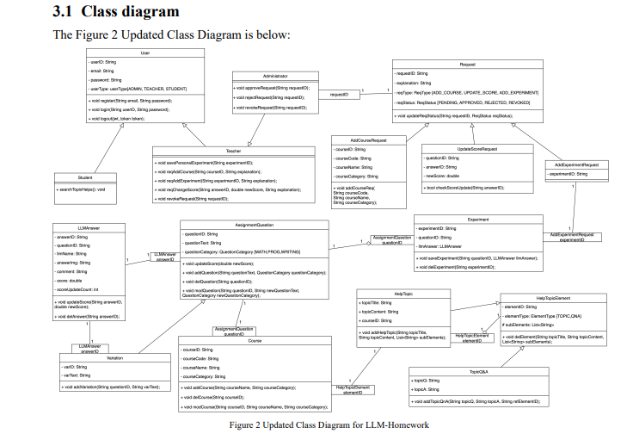

Slide 22
Student Task 1: Prepare Detailed Design Document
Students finish the Detailed Design Document according to the template.
Follow guidelines in “Issue 2: Detailed Design Template Explanation” in previous slides.
Deadline: 23:59 Saturday 25 April 2026
You have 1 more day than usual.
Each team submits the Detailed Design document, ONE copy into iSpace and GitLab.
On the cover of the documents next to the student names, leaders (with the support of most of the team) indicate how much each member contributed: Full, Fair, Little or None.
4/22/2026
22
Notes:
1. Project introduction I simply shows the students first simple version of the project description which is on iSpace already
2. Interview skills introduce very common interview skills used in industry like email, phone, face to face, question list
3. The purpose to explain SRS is for students to further understand, before start a software development, what should be known. Students shall ask the questions so they can fill in the SRS document. So question list version 2 should be more complete and organized.
4. Students should not ask the questions in the following areas. These are not issues in “Software Requirements”
Cost
– Delivery schedules
– Reporting procedures
– Software development methods
– Quality assurance
– Validation and verification criteria
– Acceptance procedures.
5. So far, we will not tell students the development language that will be used. The decision on language should be put as late as possible.
6. We will behave in the role of customer or client who knows very little about computers. Students should ask in a way that such clients are able to understand. Therefore, they should avoid the use of jargon.
7. In the SRS template, there is an explanation about each section. More attentions should be paid here:
1)Section 1.1 is not the purpose of this project, it is the purpose of this document.
2)References are not software engineering books. It is about the documents in a company which is related to this system and can help understand this system.
3)Software interface exists only when a software system is a subsystem or a module of a whole system. 4)Hardware exists when embedded software is developed.

Slide 23
Next Week in Lab 9
You will watch videos on unit testing.
Please bring your earpiece to class, if you don’t like the headphones in the lab.
4/22/2026
23

Slide 24
Teachers Issue 3: Mapping Class Diagram to Code (Can do in SE lecture.)
Next week. Ask TA to prepare tutorial for Lab 10 Coding
A document on “Mapping Diagram to Code” is on iSpace.
General rules are mentioned in how to mapping class diagram to code
Remember, besides participating classes in the class diagram, there are also control classes and boundary classes.
Fundamental rules
No participating classes in class diagram will access the control classes and boundary classes.
All the classes in the class diagram (after restructuring) should appear in the code
4/22/2026
24
Notes:
1. Project introduction I simply shows the students first simple version of the project description which is on iSpace already
2. Interview skills introduce very common interview skills used in industry like email, phone, face to face, question list
3. The purpose to explain SRS is for students to further understand, before start a software development, what should be known. Students shall ask the questions so they can fill in the SRS document. So question list version 2 should be more complete and organized.
4. Students should not ask the questions in the following areas. These are not issues in “Software Requirements”
Cost
– Delivery schedules
– Reporting procedures
– Software development methods
– Quality assurance
– Validation and verification criteria
– Acceptance procedures.
5. So far, we will not tell students the development language that will be used. The decision on language should be put as late as possible.
6. We will behave in the role of customer or client who knows very little about computers. Students should ask in a way that such clients are able to understand. Therefore, they should avoid the use of jargon.
7. In the SRS template, there is an explanation about each section. More attentions should be paid here:
1)Section 1.1 is not the purpose of this project, it is the purpose of this document.
2)References are not software engineering books. It is about the documents in a company which is related to this system and can help understand this system.
3)Software interface exists only when a software system is a subsystem or a module of a whole system. 4)Hardware exists when embedded software is developed.

